Slide 1
Exponential Weighted
Moving Average (EWMA)
Renato R. Maaliw III, DIT
Professor 1, College of Engineering
Southern Luzon State University
Lucban, Quezon, Philippines

Slide 2
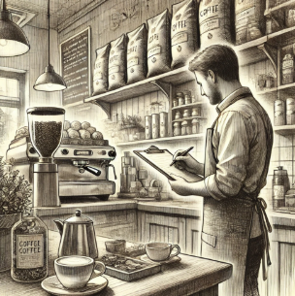
Motivation:
Imagine you are managing coffee shop. Every day, you order coffee beans based on your past sales.

Slide 3
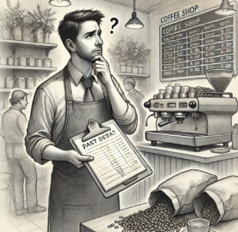
Motivation:
Recently, you noticed sudden changes: some day you run out early, other days you have left overs.

Slide 4
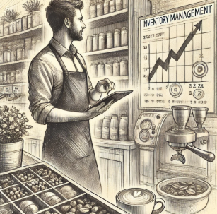
Motivation:
How can you adjust quickly to avoid disappointing customers and lost profits?

Slide 5
This is where EWMA helps!
By using EWMA, you prioritize recent sales information to quickly adapt your orders, ensuring you always have the right amount of coffee beans.

Slide 6
EWMA
a statistical method used to analyze data trends over time.
unlike SMA, it assigns importance (“weight”) to recent observations, with older data gradually receiving less importance.

Slide 7
Why use EWMA?
recent data carries more relevance that older data
data contains noise or random fluctuations
rapid detection of changes is crucial

Slide 8
Key Components:
1. Smoothing Factor (λ – lambda)
- determines the emphasis given to recent data
- value ranges from 0 to 1
- a higher λ indicates more emphasis on recent data

Slide 9
Key Components:
2. Previous EWMA value
- the previous EWMA calculation influences current
EWMA, for smooth transitions and continuity

Slide 10
Motivation on Choosing the Smoothing Factor (λ)
Higher λ (close to 1)
- places significant importance on recent data
- you want quick detection of recent changes
Lower λ (close to 0)
- assigns greater weight to historical data
- you want a more stable and less volatile trend
analysis

Slide 11
Best Practices for Selecting λ
Note: There is no single perfect λ value, but this general guidelines help:
Typical values range between 0.2 to 0.5 for balanced responsiveness
Use historical data to experiment and choose a value
that best fits your situation
c) Regularly review and adjust λ, if circumstances or data behavior change

Slide 12
EWMA Formula
λ: Smoothing factor
Current Value: Most recent data
Previous EMWA: Last Calculated EWMA value

Slide 13
Simple Example
Imagine tracking website traffic daily:
Monday: 100
Tuesday: 120
Wednesday: 90
Thursday: 130

Slide 14
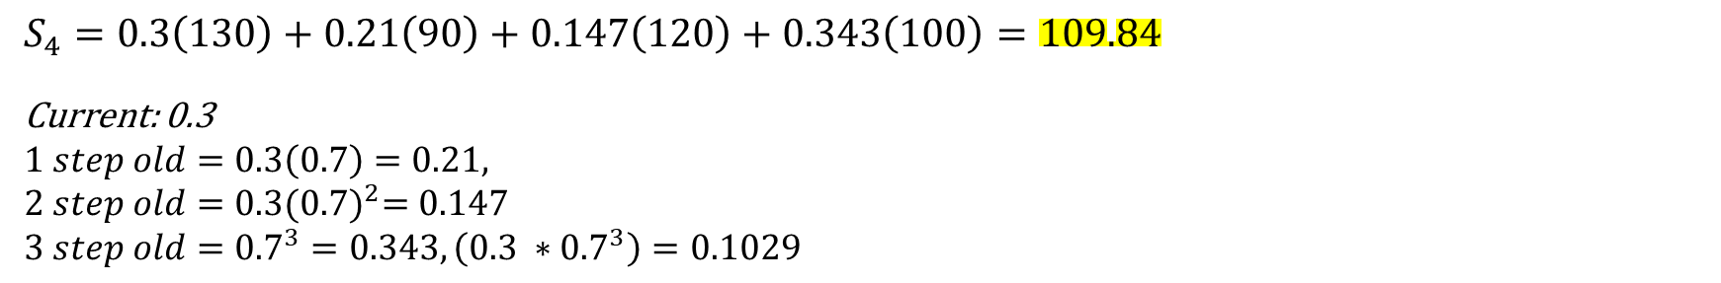
Using λ = 0.3 (moderate responsiveness)
[100, 120, 90, 130]
Monday’s EWMA: 100 (initial value)
Tuesday: (0.3 * 120) + (0.7 * 100) = 106
Wednesday: (0.3 * 90) + (0.7 * 106) = 101.2
Thursday: (0.3 * 130) + (0.7 * 101.2) = 109.84
$$S_{4}=0.3\left(130\right)+0.21\left(90\right)+0.147\left(120\right)+0.343\left(100\right)=109.84$$
Current: 0.3
$$1 step old=0.3\left(0.7\right)=0.21,$$
$$2 step old=0.3{(0.7)}^{2}=0.147$$
$$3 step old={0.7}^{3}=0.343, \left(0.3 ∗{0.7}^{3}\right)=0.1029$$

Slide 15
Using λ = 0.4 (moderate responsiveness)
[100, 120, 90, 130]
Monday’s EWMA: 100 (initial value)
Tuesday: (0.4 * 120) + (0.6 * 100) = 108
Wednesday: (0.4 * 90) + (0.6 * 108) = 100.8
Thursday: (0.4 * 130) + (0.6 * 100.8) = 112.48

Slide 16
[Code Demo]

Slide 17
01. What is the main advantage of using EWMA over a simple moving average (SMA) or rolling average?
A. EWMA gives more weight to older data
B. EWMA gives more weight to recent data
C. EWMA and SMA gives equal weights
D. Both EWMA and SMA are equally effective

Slide 18
01. What is the main advantage of using EWMA over a simple moving average (SMA) or rolling average?
A. EWMA gives more weight to older data
B. EWMA gives more weight to recent data
C. EWMA and SMA gives equal weights
D. Both EWMA and SMA are equally effective

Slide 19
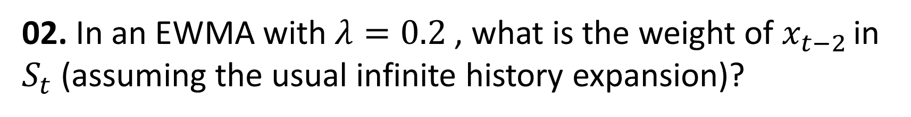
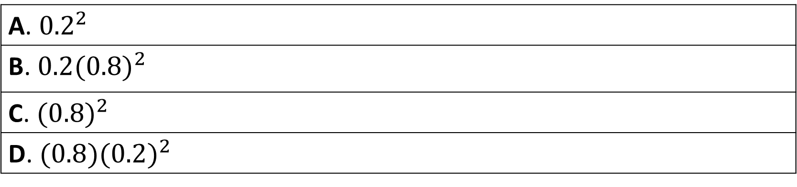
02. In an EWMA with $λ=0.2$, what is the weight of $x_{t−2 }$in $S_{t}$ (assuming the usual infinite history expansion)?
A. ${0.2}^{2}$
B. ${0.2(0.8)}^{2}$
C. ${(0.8)}^{2}$
D. ${(0.8)(0.2)}^{2}$

Slide 20
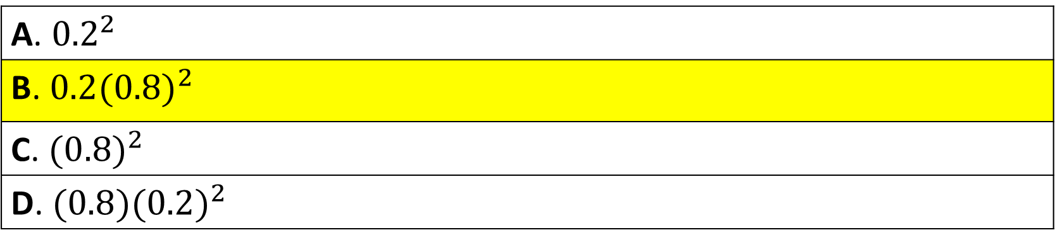
02. In an EWMA with $λ=0.2$, what is the weight of $x_{t−2 }$in $S_{t}$ (assuming the usual infinite history expansion)?
A. ${0.2}^{2}$
B. ${0.2(0.8)}^{2}$
C. ${(0.8)}^{2}$
D. ${(0.8)(0.2)}^{2}$

Slide 21
03. If 𝜆=0.1, about how much weight remains on information from 10 steps ago (relative to the EWMA state)
A. About 0.9
B. About 0.10
C. About 0.35
D. About 0.01

Slide 22
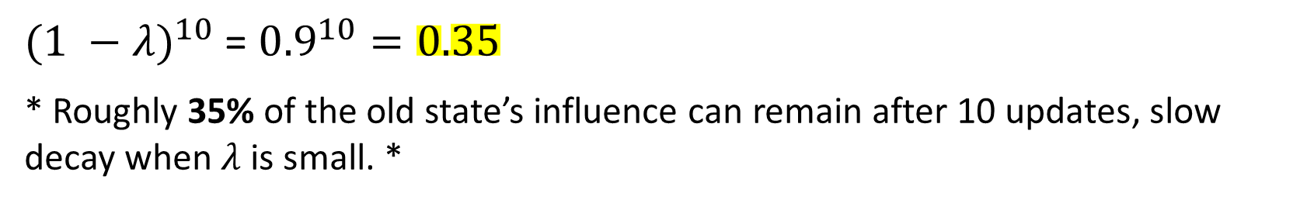
03. If 𝜆 = 0.1, about how much weight remains on information from 10 steps ago (relative to the EWMA state)
A. About 0.9
B. About 0.10
C. About 0.35
D. About 0.01
${(1 −λ)}^{10}$ = ${0.9}^{10}=0.35$
* Roughly 35% of the old state’s influence can remain after 10 updates, slow decay when$λ$is small. *

Slide 23
04. Which λ would you choose if you want the EWMA to be very smooth and not overreact to noise?
A. 0.85
B. 0.60
C. 0.30
D. 0.10

Slide 24
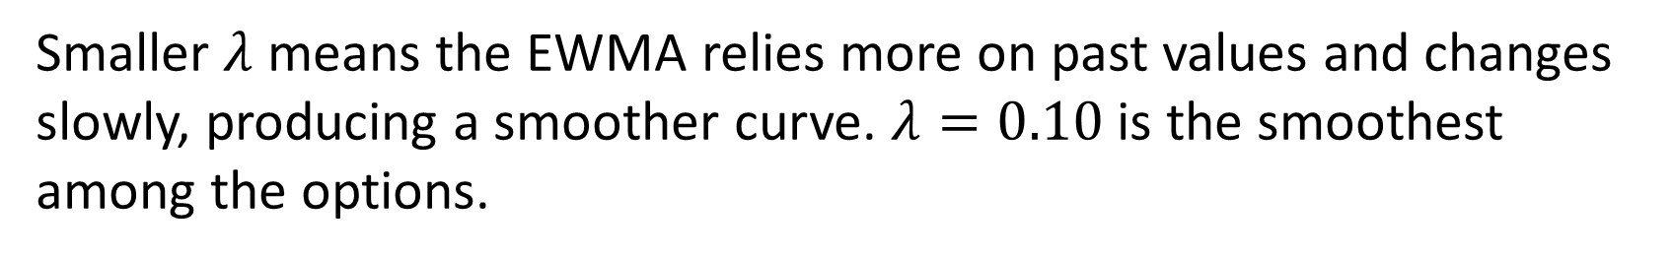
04. Which λ would you choose if you want the EWMA to be very smooth and not overreact to noise?
A. 0.85
B. 0.60
C. 0.30
D. 0.10
Smaller $λ$ means the EWMA relies more on past values and changes slowly, producing a smoother curve. $λ=0.10$is the smoothest among the options.

Slide 25
Thank you very much for listening.

